Slide 1
Chapter 03

Slide 2
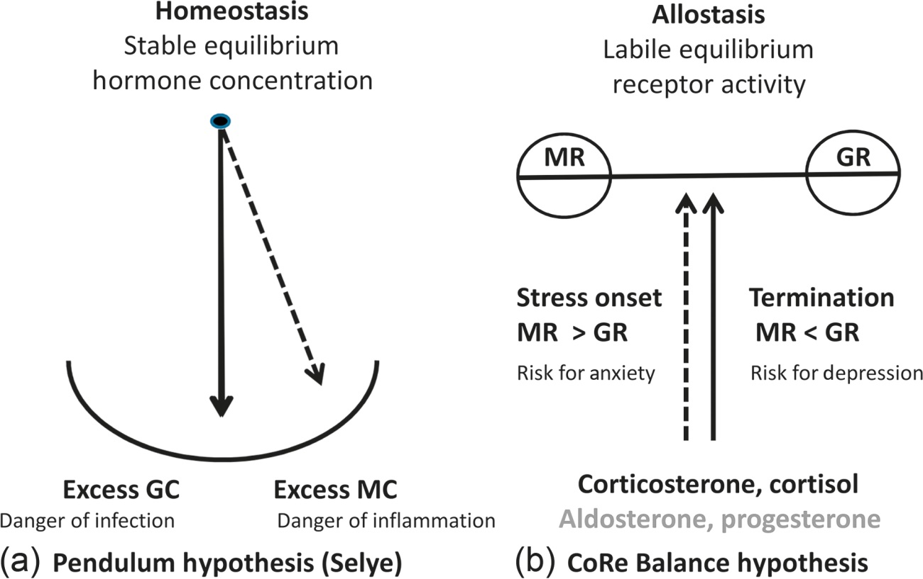
Figure 1 Hypotheses. (a) Pendulum hypothesis as formulated by Selye¹ more than 60 years ago showing the balance in action between mineralocorticoid (MC) and glucocorticoid hormones (GC) maintaining. Excess MC was thought to enhance the danger of inflammation; excess GC the danger of infection. This hypothesis was focused on maintaining a stable equilibrium or homeostasis. (b) Corticosteroid receptor balance hypothesis (CoRe Balance) showing the balance of MR:GR-mediated actions maintaining a labile equilibrium.^{6–9} The extent of MR and GR activity can slide over the two arms as a function of hormone concentration and receptor properties. MR is concerned with emotional reactivity and excess MR over GR seems linked with anxiety and aggression-driven disorders. Inadequate MR vs. GR is a characteristic feature of major depressive disorder. Dashed line represents a different hormone concentration.

Slide 3
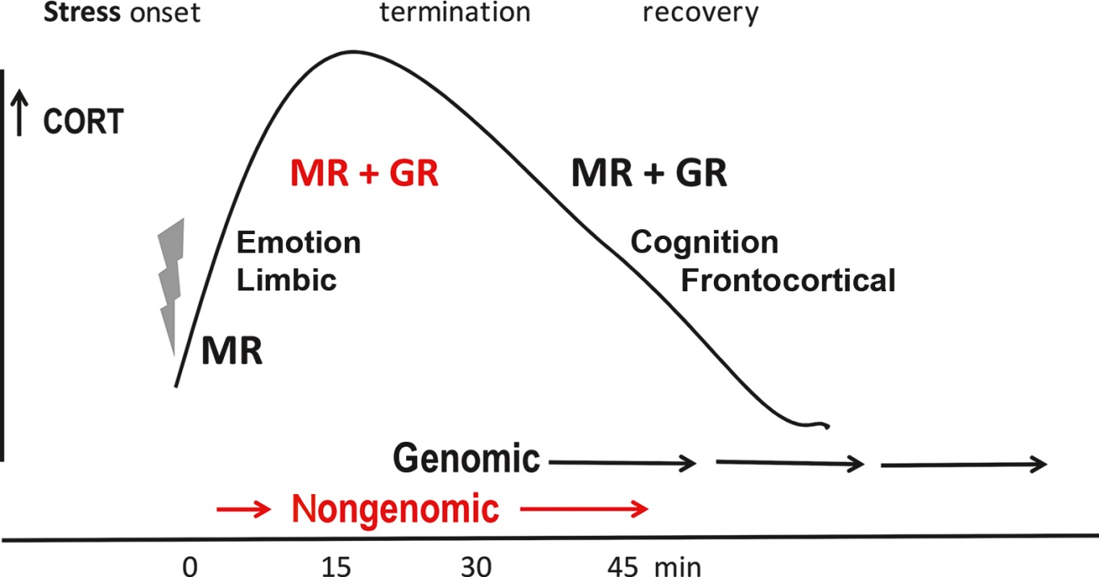
Figure 2 Time-dependent CORT action on processing of stressful information. CORT action on stress onset, termination, and recovery. Increasing CORT concentration initially affects emotional reactivity via nuclear MR and then progressively activates also nuclear GR to reallocate energy to circuits underlying behavioral adaptation and memory storage of the experience. CORT returns to baseline oscillations allowing recovery. In red: membrane MR and GR have a lower affinity and rapidly respond to rising CORT concentrations, while the nuclear receptors mediate CORT action on gene transcription with a slow onset producing primary, secondary, etc. waves of gene transcripts.
Adapted from de Kloet.⁸

